Slide 1
NEUROMEND
An ICT313 Games Technology Project
By Tempest
Ary Bizar, Anopan Kandiah, Hannah Klinac, Alex Mlodawski, Bryan Yu

Slide 2
Introduction
Project Name: Neuromend
Team Name: Tempest
Team Members:
Ary Bizar
Anopan Kandiah
Hannah Klinac
Alex Mlodawski
Bryan Yu
Client: Shri Rai
Supervisor: Fairuz Shiratuddin

Slide 3
Project Management
Methodology
SCRUM
Several changes to the requirements occurred during the project’s lifecycle and adopting this methodology has helped meet deadlines in that respect.
Weekly team/supervisor meetings
Discussed requirements
Discussed issues
Demonstrated prototypes
Source code control
GitHub
Separate folders for each device
Folder for documentation

Slide 4
Background
Stroke
Interrupted blood flow to the brain
Lack of oxygen causes brain cells to die
Motor, sensory, and cognitive problems
Rehabilitation
Neurogenesis
Rewiring

Slide 5
Problem
Rehabilitation
Expensive
Tedious/boring
Limited

Slide 6
Solution
Virtual Simulation
3 worlds
Devices
Oculus + Keyboard and mouse
Oculus + Razer Hydra
Oculus + Kinect
Oculus + Leap Motion
Sensitivity/Settings
Monitoring progress
Profiles on a database

Slide 7
The World
Immersive environments
Consistency between levels
Interesting visuals
Tasks
Simplistic
Varied

Slide 8
Database

Slide 9
Razer Hydra (Bryan)

Slide 10
Kinect (Alex + Anopan)

Slide 11
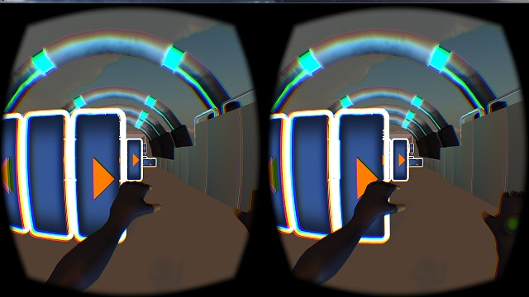
Kinect Object Avoidance
Moves player forward automatically at an adjustable speed.
4 gestures-
Strafe left
Use of left hand only
Strafe right
Use of right hand only
Jump
Use of both hands
Crouch
Use of both hands
Degree of hand/arm movement is dependent on the sensitivity setting.

Slide 12
Leap Motion (Hannah)

Slide 13
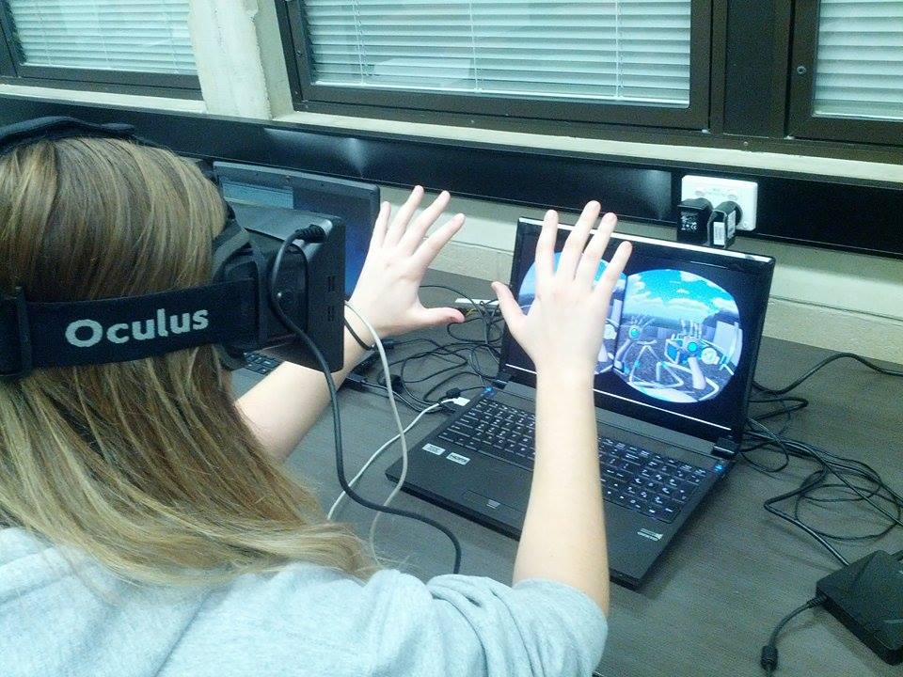
Leap Motion (Hannah)

Slide 14
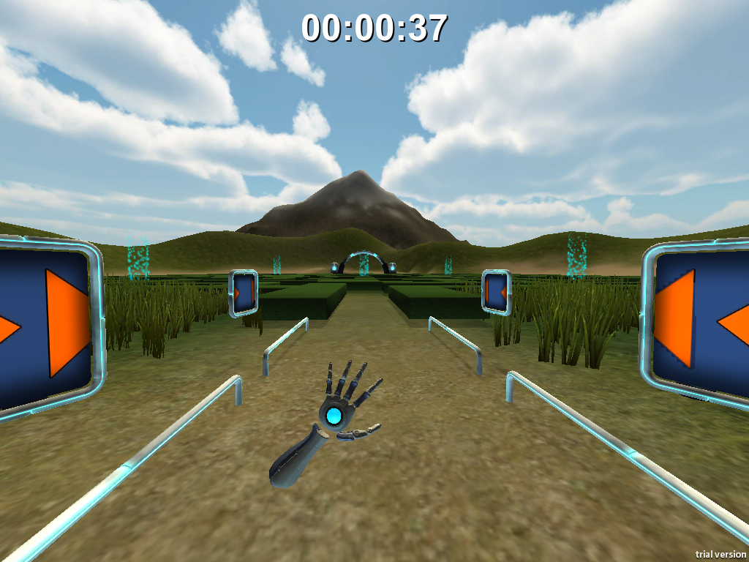
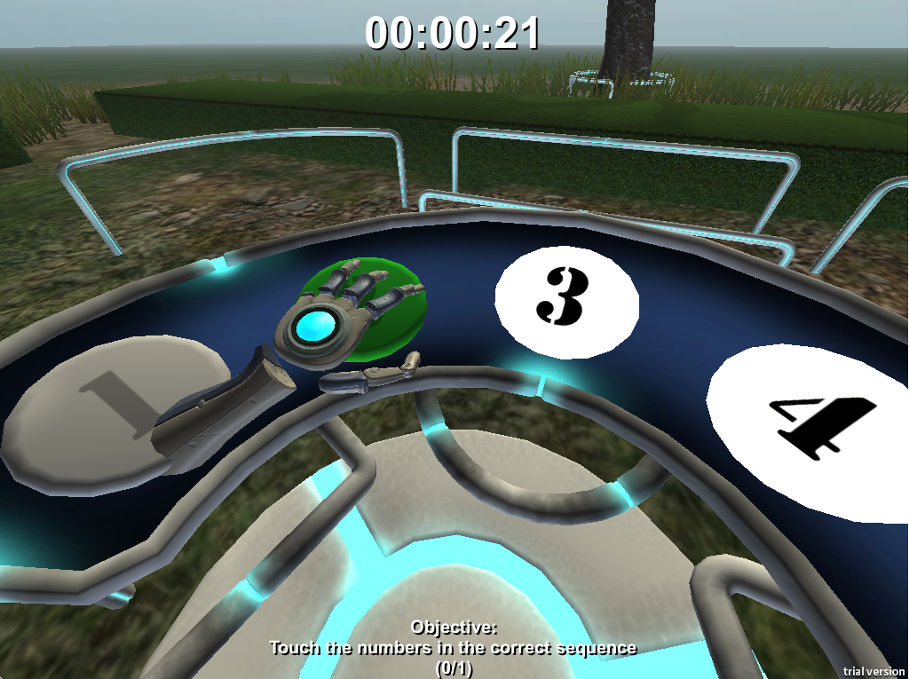
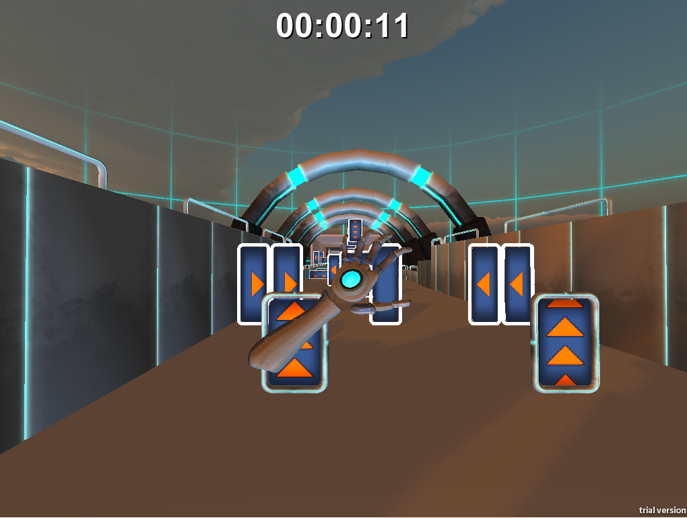
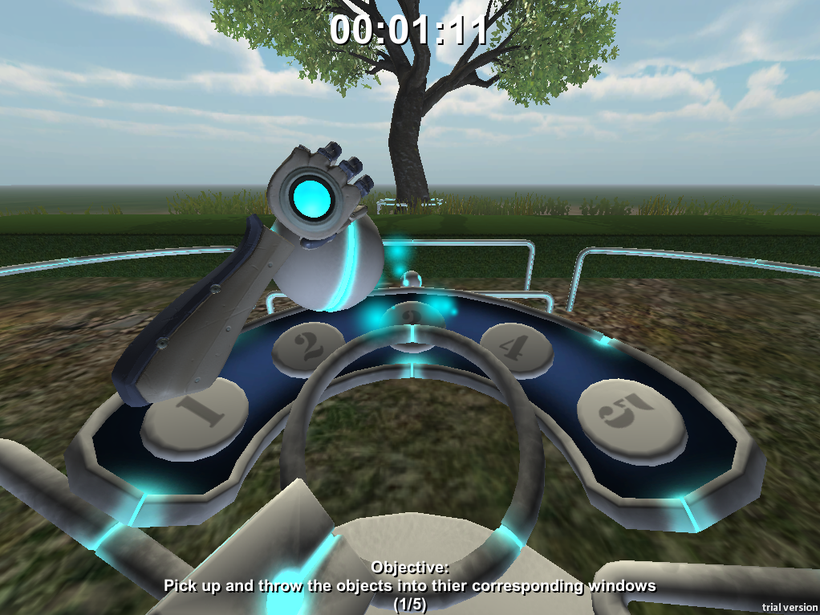
Leap Motion

Slide 15
Current Status
Virtual Simulation
3 levels
Devices
Database
Sensitivity/settings

Slide 16
Future Possibilities
Clinical use
Adding speech
Future devices

Slide 17
Challenges and Lessons Learned
Devices
Beta products
Driver clashes
Versions/compatibility
Designing movements/gestures
Version control (levels + devices)
Communication

Slide 18
Acknowledgements
Client – Mr Shri Rai
Supervisor – Dr Fairuz Shiratuddin

Slide 19
Questions?

